Slide 1


Academic integrity and the University Library’s role in the doctoral education.
Lene Østvand & Helene N. Andreassen
UiT The Arctic University of Norway
LILAC, Swansea, 10-12 April 2017

Slide 2

How to ensure high quality research when the incentives emphasize quantity?
Good scientist
Good academic
(Edwards & Roy, 2017, Carter, 2015)

Slide 3
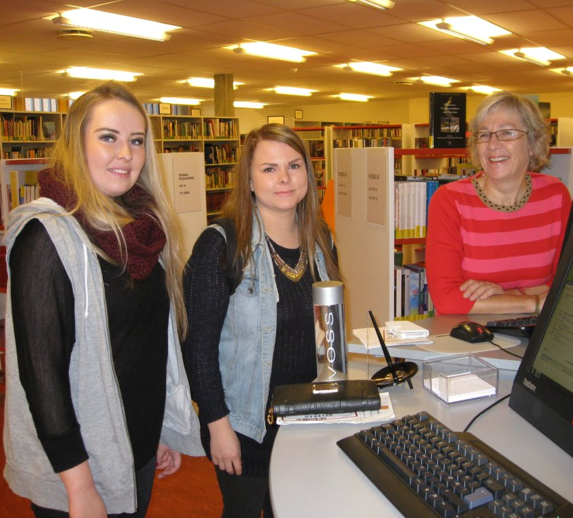
The
University
Library can help!
Photo: University Library

Slide 4



The library supports open science!

Slide 5
Outline
“Take Control” in brief, ideas and reactions,
the library’s role revisited, the road ahead

Slide 6

Take Control of your PhD journey
Academic Integrity - Literature search - Reference management - Open access publishing - Research data management
Photo: Lene Østvand

Slide 7
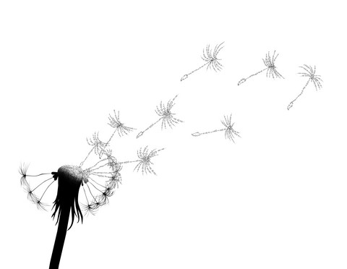
Academic integrity
and responsibility for information sharing.
“Open science contributes to conceptual advancement of research information literacy for further generations of researchers.”
(Steinerová, 2016)

Slide 8
The study
Feedback during seminars - Course evaluations – Own reflections
Pre-surveys – Post-surveys

Slide 9
  Academic integrity as a gateway
  to good science
  Scientific culture displays a constant shift of values and interests.
  Responsibility lies on the individual, the institution, and the scientific enterprise as a whole.
  For science to serve its purpose, measures should be taken on each level.
(Sovacool, 2008)

Slide 10
What would the PhD students do if they found irregularites in
research data or other research content?

Slide 11

Most would take action, but if it’s after submission, it depends more on the severity.
In their own research

Slide 12

Research by other people
Most would take action, but wouldn’t know how!

Slide 13
  Academic integrity as a gateway
  to open science
  Transparency is a key element in research integrity and trust.
  The model frameworks supporting open science practice may be viewed as transparency tools.
(Lyon, 2016)

Slide 14
What do the PhD students think of open science?

Slide 15

Open access publishing
Prestige and IF affect choice of publisher.
But transparency and high quality are also prestigous!
Notes:
Before attending the seminar on open access publishing, the PhD students had a quite clear idea of what open access is, but tend to think mostly of oa through publisher. They were less familiar with open repositories and self-archiving.
We have discussed prestige with the PhD students and how this affects open science. When it comes to publishing articles, we cannot avoid that impact factor influence choice of publisher.
Before the seminar, they already knew that IF is not necessarily a good measure of quality, but most thought that IF is important for prestige.
During the seminar, the participants seemed quite reflected, and talked about how ensuring high quality through transparency is essential for good research, and that good research is in itself prestigous.
After the discussions, they considered IF less important for prestige. They agreed that transparency through OA publishing is important for prestige, and especially for integrity. They were focused on academic values, rather than giving in to the pressure of the more cynical view of prestige.

Slide 16

Open data
General positivity towards sharing research data, but far less knowledge!

Slide 17
What is the PhD students’ experience
of the incentives emphasizing quantity?
Does this change over time?

Slide 18
“As a PhD student, I find it hard to balance the pressure to do good research and the pressure to publish quickly.”
Semester 5
Score 9
Semester 1
Score 1

Slide 19

  Do we meet their needs?
  Increasing open access publishing,
  but nature of open access is not fully understood.
  Data is mostly shared with their work colleagues,
  as they fear others will not understand the data correctly.
  (Education for change, 2012)

Slide 20

The road ahead
Even stronger focus on research data and correct use of sources!
Photo: Lene Østvand

Slide 21
The road ahead
Spring 2018:
Formally integrated in the course catalogue at UiT.
Award 1 credit (ECTS).
Photo: Lene Østvand

Slide 22
The library is an important contributor
to the UiT’s open science strategy!
Colourbox.com

Slide 23
References
Carter, G. (2015, August 12). Goals of Science vs. Goals of Scientists (& a love letter to PLOS One) [Web blog post]. Retrieved from https://socialbat.org/2015/08/12/goals-of-science-vs-goals-of-scientists-a-love-letter-for-plos-one/
Education for change. (2012). Researchers of tomorrow: the research behaviour of generation Y doctoral students. Retrieved from http://www.webarchive.org.uk/wayback/archive/20140614040703/http://www.jisc.ac.uk/media/documents/publications/reports/2012/Researchers-of-Tomorrow.pdf
Edwards, M. A. & Roy, S. (2017). Academic Research in the 21st Century: Maintaining Scientific Integrity in a Climate of Perverse Incentives and Hypercompetition, Environmental Engineering Science. 34(1): 51-61. doi:10.1089/ees.2016.0223.
  Lyon, L. (2016). Transparency: the emerging third dimension of Open Science and Open Data. LIBER Quarterly, 25(4), 153–171. doi:10.18352/lq.10113
Sovacool, B. K. (2008). Exploring scientific misconduct: isolated individuals, impure institutions, or an inevitable idiom of modern science? Journal of Bioethical Inquiry, 5(4), 271-282. doi:10.1007/s11673-008-9113-6
  Steinerová J. (2016) Open Science and the Research Information Literacy Framework. In: Kurbanoğlu S. et al. (eds) Information Literacy: Key to an Inclusive Society. ECIL 2016. Communications in Computer and Information Science, vol 676. Springer, Cham
  All pictures are from colourbox.com if not otherwise stated

