Slide 1


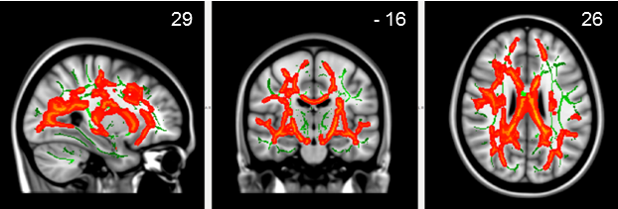
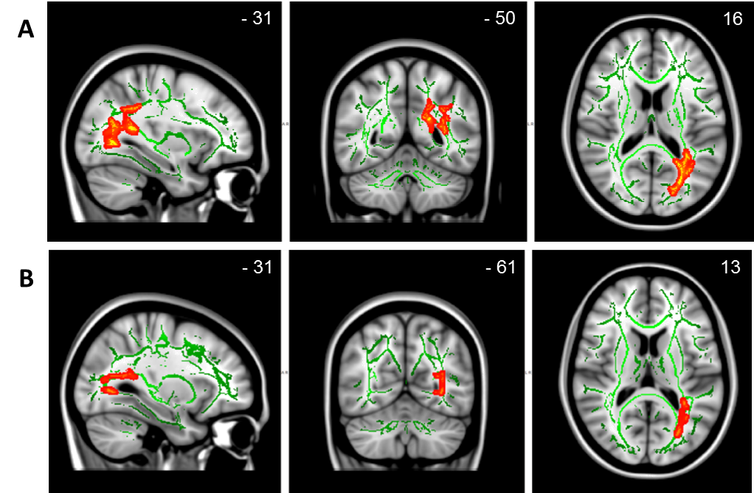
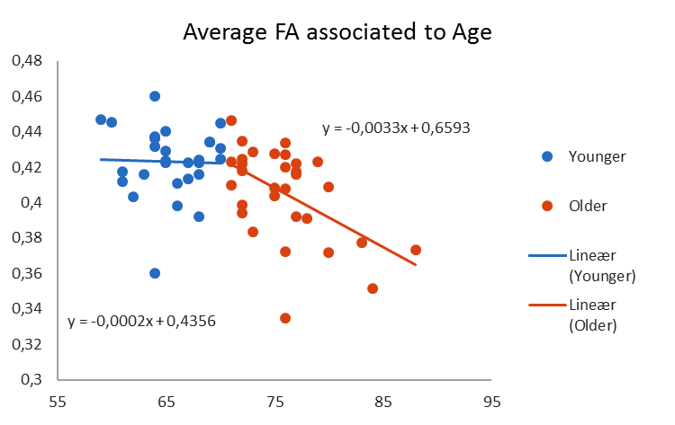
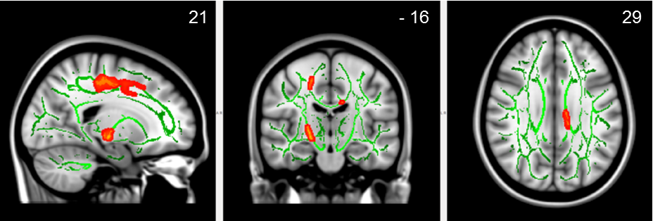
Association of white matter integrity and gait speed during dual-tasking among community-dwelling elderly adults
Poster 2017-S-12337-SfN
Susana A Castro-Chavira¹, Torgil R Vangberg², Marta M. Gorecka¹, Olena Vasylenko¹, Knut Waterloo¹, Claudia Rodríguez-Aranda¹
  ¹Fac. of Hlth. Sciences, Dept. of Psychology, Univ. of Tromsø, Tromsø, Norway;
  ²Dept. of Radiology and Nuclear Med., Univ. Hosp. North Norway, Tromsø, Norway
Objective
Changes occurring in gait and attention during normal aging increase the incidence of falls. To date, few studies have explored the role of age-related white matter degeneration on gait disturbances raised by performing a cognitive task while walking. This study uses the dichotic listening (DL) test to challenge gait in a dual-task paradigm. DL evaluates lateralized auditory attention with 3 different levels of difficulty.
Methods
Two age groups of right-handed elderly:
29 younger (M = 65.52, 59-70 years old), and
31 older (M = 75.87, 71-88 years old)
Pure tone audiometry was conducted. The Optogait©-system was used to obtain gait speed measurements (mean and coefficient of variation) at baseline and while performing DL during four conditions:
MRI Acquisition
Single-shot SE-EPI sequence with TE/TR = 80/10,700 ms, 70 axial slices, slice thickness 2.25 mm, and FOV252 x 252 mm in a Siemens Skyra 3.0T scanner.
DTI Analysis
White matter integrity was evaluated by fractional anisotropy (FA) using Tract-Based Spatial Statistics (TBSS). Non-parametric permutation analysis using threshold-free cluster enhancement (P = 0.05) and the general linear model applied to the TBSS analysis were used.
Results
Gait Performance
The younger group presented faster average speed than the older group in the BL, FR, and FL conditions. No group differences existed in speed during the NF condition.
Group differences
The younger elderly group showed significantly (p < 0.05) larger FA, predominantly in the left hemisphere. The correlations for FA and age showed a significantly larger negative slope in the older group.
There was a significant effect of gender on FA with women showing larger FA values in right superior longitudinal fascicle, corticospinal tract, and body of the corpus callosum.
Correlations between FA and speed in dual-tasking
The NF speed mean was positively associated to larger FA values in the younger group in left optic radiation and splenium of the corpus callosum, inferior longitudinal fasciculus, and cingulum (A). Conversely, larger FA values in the younger group were negatively associated with FL speed variability (coefficient of variation) in the left inferior longitudinal fasciculus, left inferior fronto-occipital fasciculus and optic radiation (B).
Conclusions
Results of the present study showed significant associations for the DL conditions (NF and FL) presenting higher difficulty for right-handed subjects. This data indicate that in healthy elderly, faster gait velocity and lower speed variability (i.e. less instability) under demanding conditions depend on better integrity of left hemispheric white matter tracts.
E-mail: susana.a.chavira@uit.no; claudia.rodriguez-aranda@uit.no
Non-forced
condition
ASSESSMENT CONDITIONS
Baseline
(gait alone)
Baseline – BL
(not listening)
Dual-Task
(gait + listening)
Non-forced – NF
(unrestricted attention)
Forced right – FR
(right ear listening)
Forced left – FL
(left ear listening)
Significantly larger FA values in the younger elderly group (p < 0.05).
Forced-left
condition
Significantly larger FA values in the younger elderly group (p < 0.05).
Gender Effect
Significantly larger FA values in the female (p < 0.05).

