Slide 1
NERA 2023 – STEP symposium
I

Slide 2
Partnership for Sustainable Transition from Teacher Education to the Profession (STEP): Becoming a professional teacher
Research leader professor Eva Bjerkholt,
University of South-Eastern Norway
Notes:
The initial teacher education (ITE) in Norway has been reformed from bachelor to master (M-ITE). The first cohort of graduated students started in 2017 and will be NQTs in the schools in the autumn 2022. STEP focuses on this cohort.

Slide 3
STEP: A collaborative and knowledge-building project
One of the novelties of STEP is the unique collaboration between researchers and stakeholders, the combination of research- and experienced based knowledge and the knowledge of policymaking in Norway and internationally.
Notes:
In 2017 The Norwegian Parliament made a parliamentary resolution which stated that stakeholders shall collaborate on designing a mentoring system that includes all NQTs nationally (44). The agreement specifies the roles and obligations of the various stakeholders.
STEP’s excellence lies in bringing together researchers in teacher education and the main stakeholders nationally in order to influence on further developing the national framework for mentoring beginning teachers (27). The novelty of STEP is the unique collaboration between researchers and stakeholders, the combination of research- and experienced based knowledge and the knowledge of policymaking in Norway and internationally
The study revealed a need for research-based knowledge on how M-NQTs’ academic and didactical competence is appreciated and valued as relevant by different actors in school and how the first cohort from M-ITE is positioned and addressed in schools.

Slide 4
The partners are:
Researchers from University of South-Eastern Norway (USN)
Researchers from Norwegian artick university: University of Tromsø (UiT)
Partners from these organisations:
The Norwegian Association of Local and Regional Authorities (KS)
Union of Education Norway (UEN)
Norwegian Teacher Student Union

Slide 5
Primary object
Based on collaboration, STEP will develop research- and experience-based knowledge on transition from Master Initial Teacher Education (M-ITE) into the teacher profession in order to influence the further development, implementation and institutionalization of the Norwegian national framework for mentoring Newly Qualified Teachers (NQTs) as a coherent induction and mentoring system for individual and collective learning for M-NQTs and for mutual learning in schools.
Notes:
We need research-based knowledge on actors’ expectations and perspectives on whether M-NQTs’ academic and didactical competence is relevant.
STEP will examine how the actors’ expectations and perspectives influence M-NQTs’ motivation to remain in the profession.
We also need research-based knowledge of the consequences of actors’ expectations for important aspects related to the three key factors. As such, we need research-based knowledge that includes and combines these three key factors and explores critically M-NQTs’ professional learning to identify important aspects for developing sustainable systems for continuing professional learning after M-ITE. STEP will address this need to provide a research- and experience-based knowledgebase for policymaking to develop M-ITE and the national framework for inducting and mentoring NQTs

Slide 6
Research questions
what expectations do students and their future colleagues, school leaders and owners have for the newly qualified teachers' mastery of the challenges they face in school?
how the graduates' professional competence and insight into research valued and used in school?
what measures can help retain graduates in the profession and be part of a comprehensive strategy for career development and competence enhancement in schools?
how research-based knowledge can contribute to developing the national framework for mentoring newly qualified teachers.

Slide 8
(Dis)Engaging teacher students in constative, critical and constructive research during teaching education
Yngve Antonsen, Marit Ulvik, Ove Gunnar Drageset, Knut Rune Olsen, Finn Rudolf Hjardemaal, Kari-Anne Sæther, Auli Toom.
Notes:
Most give you an insight of the conceptualization of the paper.
Antonsen, Jakhelln, Aspfors & Bjørndal (In publication) Solo, collaborative or collective? Newly qualified teachers’ experiences of being stirred into induction practices. European journal of teacher education.

Slide 9
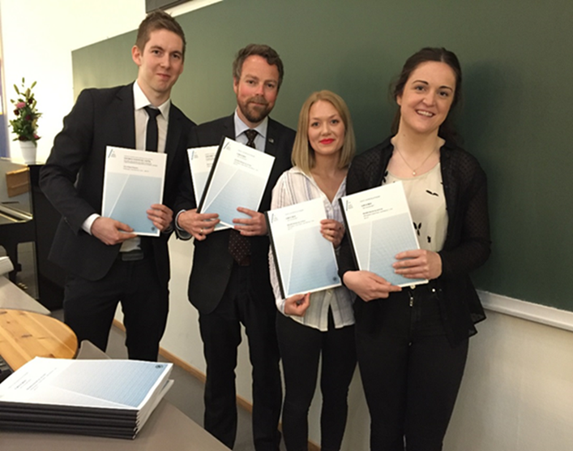
Master-based teacher education – Finland and Norway
Analysis of master thesis in Norway and Finland reveal intensive use of interview studies (Sæther et al., 2022, Eklund,2019)
STEP – shock: Norwegian teacher students negative to their education – not relevant for practice
Notes:
Alt er jo research –based teacher education
Finland long history
Piloted at UIT 2010, introduced in Norway 2017

Slide 10

Research that keeps teacher students «close to practice»
Research questions: What kind of research knowledge and capabilities may teacher students need from their master-based teacher education to be prepared for their professional work?
Notes:
Teachers work is mastering the classroom and other varied tasks

Slide 11

Research literate teachers
Involves knowing research designs and research methods, having a critical mindset, being updated on research findings, and understand it’s implication for practice (Furlong et al 2014)

Slide 12
Research approaches (Kalleberg, 2009)
Constative research designs have the purpose to understand cause- effects and get causal clear answers about what to do (Kalleberg 2009). Biesta (2015) describes as the ”technological term”.
Critical research designs have the purpose of evaluating social realities and especially looks into differences in social and psychological conditions to find out what is stable and what can be socially improved (Kalleberg 2009).
Constructive research designs have the purpose of contribute to the transformation of social realities and to identify precisely what is unique or special (Kalleberg 2009). Finding insights that would improve existing structures or practices.
Notes:
“what can and should actors do to improve their situation” (Kalleberg 2009, 266).

Slide 13

Observation and interviews for understanding and interpretation
Study practices in different levels of the teacher education with critical designs.
Develop teacher students capabilities to observe pupils or colleagues during their work
Bring insights in practices that needs to be developed, and to gather data (understanding) of how actions are going., or for understanding what is going on in the classroom
.
Notes:
To example observe a experienced teacher first year or students third year
Observe experienced teachers first year
Observere a student more coherently
År 1: observasjon, intervju og etikk – observere en lærer
År 2: Observasjon og systematisk innsamling av elevarbeid som tekster, tester eller andre arbeider) – lære seg elevvurdering
År 3: a) observere og utforske egen praksis
b) Utviklingsprosjekt basert på aksjonsforskning
År 5 metodekurs og masteroppgave

Slide 14
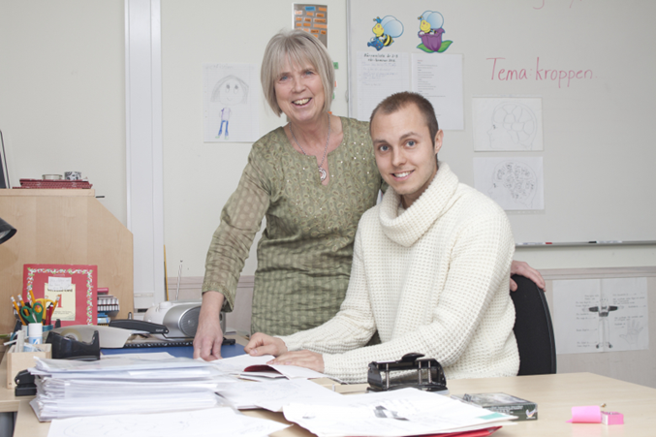
Interviews
Teacher students would benefit from learning how to ask questions to students or colleagues that reveal understanding, logic, argumentation,
Niss (2003) describes the competency to understand or reveal the students learning.
Such practice could be integrated in the practice period of the education, with the teacher students focus on student learning and follows one pupil’s development closely during practice periods.

Slide 15

Action research and lesson studies
Research literate about to access, interpret and adapt research findings to their own settings
Learning from reflections and critical reflections with the intention to understand our experiences and actions and ambition about changing and improving our practices in groups or school
Teaching, curriculum work, local school development
Notes:
A: Yes, to exercise an action. That's what made it exciting then. Because then we were allowed to try something out and change something..., but what made the whole BA so exciting was that we got to come to a school and then we were allowed to do something. We made it pretty big too. In addition, we did so throughout the internship period.
Antonsen et al. 2022
Teacher students constructive and close to their practice
Aksjonsforskning forstås da som en type intervenerende og konstruerende forskning hvor en
forsker sammen med aktørene uten på forhånd avklarte problemstillinger (Kalleberg, 1992). I
følge Kalleberg (1992) og Carr (2006) er ikke aksjonsforskning en særegen metode, eller en
særegen type data, men et helhetlig forskningsopplegg av konstruktiv karakter, fordi forskeren
aktivt deltar i forandrende inngrep i det studerte felt. Kalleberg (1992) vektlegger nettopp det
unike eller spesielle som er det forskningsmessig mest verdifulle resultatet i de konstruktive
forskningsopplegg.
Forskning hvor en lykkes med nye løsninger vil gi forskningsbidrag som
er viktigere enn alle de mislykkede løsningene en avdekker underveis. Galtung (1977) har
også poengtert at samfunnsvitenskapene ikke bare må kartlegge sosiale fenomener, men også
må kunne bidra til å endre samfunnet til det bedre. Galtung (ibid.) stiller spørsmål om hvorfor
en ellers skal ha samfunnsvitenskap?
Forbedringsarbeid i skolen er krevende- for å sikre kvalitet ønsker en at en forsker er med for å kvalitetssikrer prosessene
Aksjonsforskning er en tilnærming for å fremme forbedringsarbeid og innovative praksiser i skolene

Slide 16
References
Eklund, G. (2019). Master’s Thesis as Part of Research-Based Teacher Education: A Finnish Case. Journal of Teacher Education and Educators, 8(1), 5-20. https://doi.org/https://dergipark.org.tr/en/pub/jtee/issue/44909/559130
Furlong, J., Menter, I., Munn, P., Whitty, G., Hallgarten, J., & Johnson, N. (2014). Research and the teaching profession: Building the capacity for a self-improving education system. Final report of the BERA-RSA Inquiry into the role of research in teacher education. London: British Educational Research Association (BERA). https://www.bera.ac.uk/wp-content/uploads/2013/12/BERA-RSA-Research-Teaching-Profession-FULL-REPORT-for-web.pdf?noredirect=1
Kalleberg, R. (2009). Can Normative Disputes be Settled Rationally? On Sociology as a Normative Discipline. In M. Cherkaoui & P. Hamilton (Eds.), Raymond Boudon: A Life in Sociology. Essays in honour of Raymond Boudon (Vol. 2, pp. 251-269.). The Bardwell Press. https://doi.org/http://urn.nb.no/URN:NBN:no-24557
Niss, M. (2003). Mathematical competencies and the learning of mathematics: The Danish KOM project. 3rd Mediterranean conference on mathematical education,

Slide 17



Slide 18
Master`s education as a fundament for mutual learning
Janne Madsen og Eva Bjerkholt
Pedagogical department, University of South-east Norway (USN)

Slide 19
Background, Context and Research Question
New teacher education
  Master`s thesis
  Academic knowledge
  Research question: Does working with and writing a master`s thesis prepare the student teachers for mutual learning?
Notes:
Newly qualified Norwegian teachers are academically educated through five years of education and end up with master`s thesis. In school the new teachers work in different groups and relations with colleagues, mentors, school leaders etc. Based on our research question we explore whether, and possibly how, writing a master`s thesis can prepare the students for professional discussions, development and collaboration involving the NQTs, their mentors and their colleagues? We look for mutual learning when exploring the question: Does working with and writing a master`s thesis prepare the student teachers for mutual learning? How, why/why not, for whom, etc? The process of writing a master`s thesis is not only about writing, but also includes to decide on a theme, to recognise a challenge, to formulate a research question, to read and understand theoretical text, etc. Etc. This is a process where submitting a master`s thesis is the endpoint.

Slide 20
Research methods
Two research circles meet and discuss
Recordings
Transcriptions
Analysis
Preliminary categories
  Coherence between mutual learning and relevant theoretical content.
  The importance of research methods relevant for a future teacher
  Skills of collaboration and mutual learning
Notes:
Two research circles in the STEP-project have discussed questions relevant for NQTs with a master`s thesis.
The participants in our research circles are a head of school in a municipality, a headmaster from a public school, a newly qualified teacher, a teacher who qualified one year ago, a mentor for NQT`s, a phd student, an observing researcher and a researcher leading the circle.
These groups meets for two hours, six times each year and discuss questions/themes chosen by the researchers. Each meeting is digital, the participants represent the whole country.
The meetings are recorded, transcribed and analyzed by coding and categorizing relevant parts of the transcriptions.
This process leads us to some categories/themes framing the findings.
The process is going on we are not finished, but our preliminary categories are
1) Coherence between mutual learning and relevant theoretical content. We expect to develop knowledge about the importance of pointing the theoretical content in subjects, in teacher education, towards practice (praksisnær teori) and train the students to explain and reflect together. We explore whether relevant theoretical content might prepare the students to participate actively in shared reflections and in this way in mutual learning.
The 2) category is about The importance of research methods relevant for a future teacher. We explore the characteristics of research methods relevant for improvement of professional quality and personal development.
And 3). Skills of collaboration and mutual learning. We explore how students` skills of collaboration can be relevant for them as future teachers and whether these skills are transferred to a professional community of learning.
We do not have much time today, therefore we won`t say much about 1) and 2), but jump to category 3)

Slide 21
Preliminary category 3: Skills of collaboration and mutual learning.
Writing a master`s thesis seems to be a lonely process.
Education exercising «real» collaboration might prepare the students for professional collaboration.
Professional collaboration
Notes:
3) Skills of collaboration and mutual learning.
Many statements are found in the data, three of them are these.
According to the informants, the participants in the research circle, writing a master`s thesis seems to be a lonely process on the way to a high level of knowledge. But this way of working is understood as very different from the teachers` ways of working. Teachers propose a question, a problem or a challenge and the colleagues, the team, the group of staff discuss before each of the teachers draws some kind of conclusion, and in some way or another this influences their practice teaching the pupils. The latter being a process based on collaboration and mutual learning, but working with a master`s thesis won`t in the same way prepare the future teachers for this.
Education exercising «real» collaboration (ikke «på liksom») might prepare the students for professional collaboration, it was said. The participants in the research circles propose ideas to increase the learning outcome related to being future practicians, amongst others to increase the skills of collaboration. They think that collaboration related to responsibility might lead to skills of collaboration useful for a future teacher.
A third point from the research circles was that
3) Collaboration where all the parts construct and appropriate knowledge is characterizing working as a teacher in more and more schools. The learning, in these cases, is mutual because all parts are learning. The participants in the research circles agree on this, but also say that the processes appear different in the schools, They mean that the schools should intend to include the NQT`s and put weight to the high level of academic knowledge brought into the school by the NQT`s educated with a master`s thesis .
These three statements are closely related and partly overlapping, but can lead us to some arguments for taking action both in teacher education, in mentoring of NQT`s, in education leaders and in development in schools.

Slide 22
Discussion: collaboration and mutual learning
Educating/organizing the students into loneliness?
Is it possible to learn «real» collaboration in academic studies?
Will NQT`s with high collaborative competence influence on their professional collaboration?
Notes:
All these three categories will bring us into discussions related to teacher education, to the transition from being a student to becoming a NQT and to the culture in the schools employing NQT`s and including them in the staff.
When it comes to the loneliness when writing the master`s thesis, it can be understood as a hint from the research circles to the universities: Don`t organize the students into loneliness, and certainly not for the last year of their studies just before they are to start their professional life. The NQT`s should be good at collaborating and be able to learn together with the rest of the staff when they start working.
When it comes to the question about real collaboration one could discuss whether it I possible to learn to collaborate in a situation with no shared actions. When studying, the collaborative learning ends up in individual achievements with no (or only a little) importance for the group. This is a situation where the results of the learning from the collaboration aren`t visible for the group. The participants in the research circles whish collaborative learning to be part of education in university, if this is difficult to achieve, it could, maybe, be of importance to strengthen the mentoring focus of NQT`s on collaboration?
Transfer of knowledge from teacher education to professional teacher practice is a challenge in all the Western countries. Education on still higher academic level, seems to challenge the transfer even more. The students seem to carry more and more relevant academic knowledge, at the same time as their professional colleagues carry knowledge from long experience. Collaboration and mutual learning, in this perspective, should be useful for all parties and we, in STEP, want to participate in further practical development and research in this field, to propose suggestions for achieving mutual learning through mutual learning

Slide 23
References
Bjerkholt, E. & Stokke, H.S. (2017). Et forskende fellesskap – Forskningssirkler på tvers av læringsarenaene i lærerutdanningene. Norsk pedagogisk tidsskrift, 101(2), 157-168. https://doi.org/10.18261/issn.1504-2987-2017-02-05
Hatlevik, I.K. & Havnes, A. (2017) Perspektiver på læring i profesjonsutdanninger – fruktbare spenninger og meningsfulle sammenhenger. I S. Mausethagen og J.- C. Smeby (Red.), Kvalifisering til profesjonell yrkesutøvelse (s. 191-203).Universitetsforlaget
Persson, S. (2016). Mötet mellan kunnskapsformer: forskningscirkeln och den skolnära forskningen. I E. Andeberg (Red.), Skolnära forskningsmetoder (s. 159-174). Studentlitteratur.
Røise, P. & Bjerkholt, P. (2020). Frigjørende deltakelse i en forskningssirkel om faget utdanningsvalg. Forskning og forandring 3(1), 47-69. https://doi.org/10.23865/fof/.v3.2160

Slide 25
The partners in mentoring and induction
Sonja from Norwegian Teacher student union- representing students and newly qualified teachers
Gunn from Union of education representing experienced teachers and headmasters
Magnus/Jorun from The Norwegian association of local and regional authorities representing local and regional authorities

Slide 26
Proposals from the committee:
- introduce a right to an introductory year for all newly qualified teachers in kindergartens and schools
- the entitlement must imply that 10 percent of the working time in the first year can be used for introductory activities
- further develop national frameworks for the introductory year, based on existing principles of newly qualified teachers
- the universities develop modules in supervision, for example of 7.5 credits. Some of the modules may be shared with the continuous professional development and the proposal of the career paths.

Slide 27
Why do we still choose to cooperate even though we have very different points of view?

